Slide 1


DETERMINING THE BEST MODEL FOR PRECISE FORECASTING

Slide 2

OBJECTIVE
Project's goal is to carefully assess and contrast numerous models, including
Regression
Decision Tree
Linear Regression
To determine which model most closely matches the House Prices dataset.

Slide 3
PROJECT ARTERY
Predictive Analysis
In order to precisely forecast a home's price based on a variety of features, we develop both regression and decision tree models.
Descriptive Analysis
To provide a comprehensive overview of the key features of a dataset, descriptive statistics are necessary.
Feature Selection
We compare the models using RMSE, adjusted RMSE, and R square to see which is the best.
To train the model and make predictions on the provided testing dataset, we use the House Prices.csv dataset. There are thirteen variables in the dataset.
A robust methodology for feature selection is provided by the use of ANOVA and linear regression models, as well as the analysis of the correlation matrix and heatmap.

Slide 4
DATA
PREPARATION
By addressing problems like outliers, inconsistent data, and missing values, this step improves the dataset's overall reliability. There are no missing values in our instance.
EXPLORATION
Visualization and descriptive analysis are both included in data exploration. We've already discussed the descriptive analysis, so let's get started on the visualization. Plots come in three varieties: correlation heatmap, pair plot, and histogram.

Slide 5
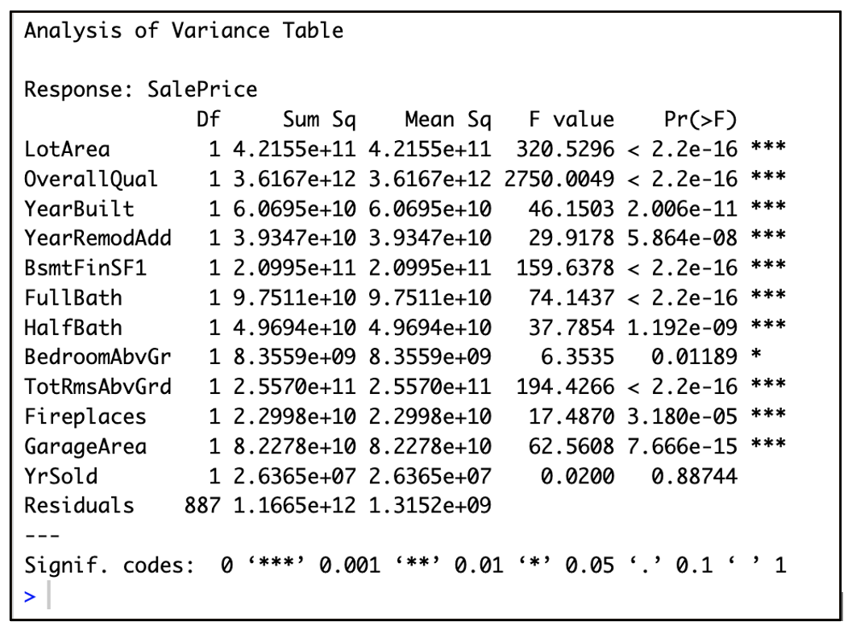
FEATURE SELECTION
The procedure for creating models for machine learning. From the initial set of features, a subset of pertinent features (variables or predictors) are selected.
The relationship A plot illustrates how various features affect the sales price output variable.
A feature selection technique called stepwise regression methodically adds or removes predictors from a model based on a predetermined criterion, like AIC or BIC.
We can create a more focused and effective model by identifying a particular feature that significantly contribute to predicting Sale Price by looking at the P-values obtained from these analysis.

Slide 6
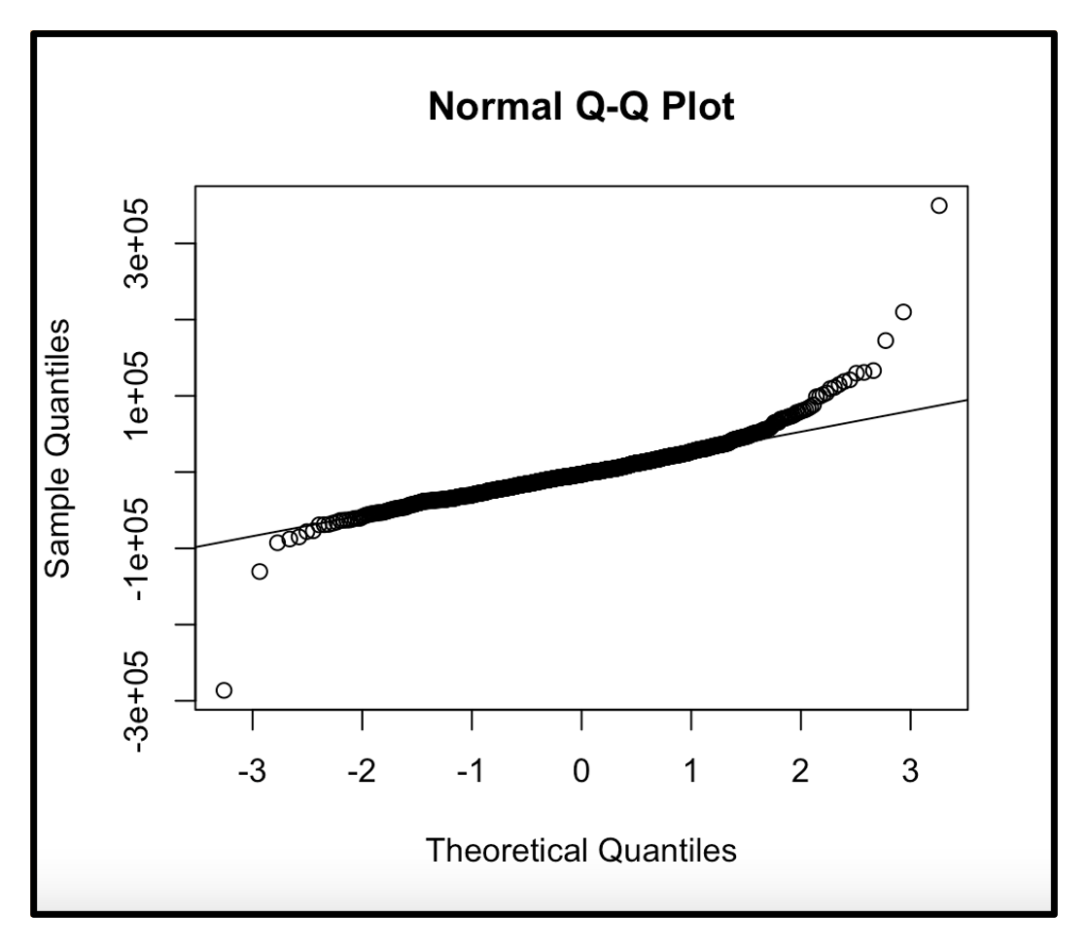
PREDICTIVE ANALYSIS
To accurately predict the price of a house based on various features, we build both Regression and Decision Tree Models in the first step of predictive analysis.
REGRESSION MODEL
An easy way to see if a dataset is roughly normally distributed is to look at a Normal QQ plot. It's a useful tool for testing hypotheses and exploratory data analysis, assisting analysts in making defensible choices regarding the suitability of statistical procedures that presume normalcy.

Slide 7
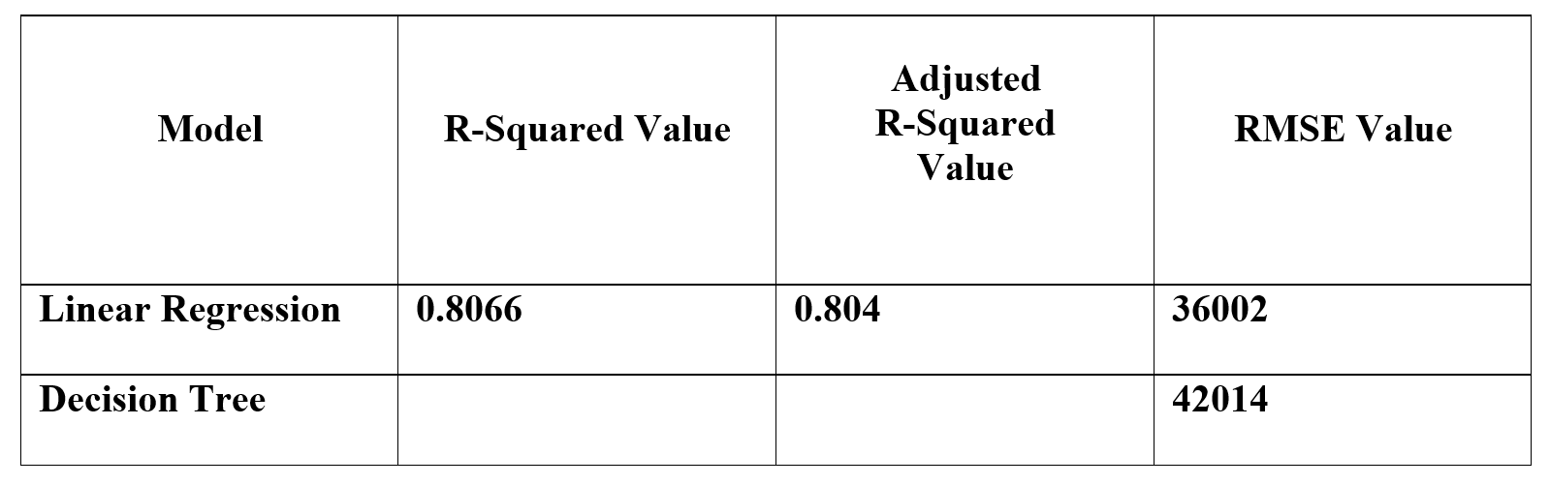
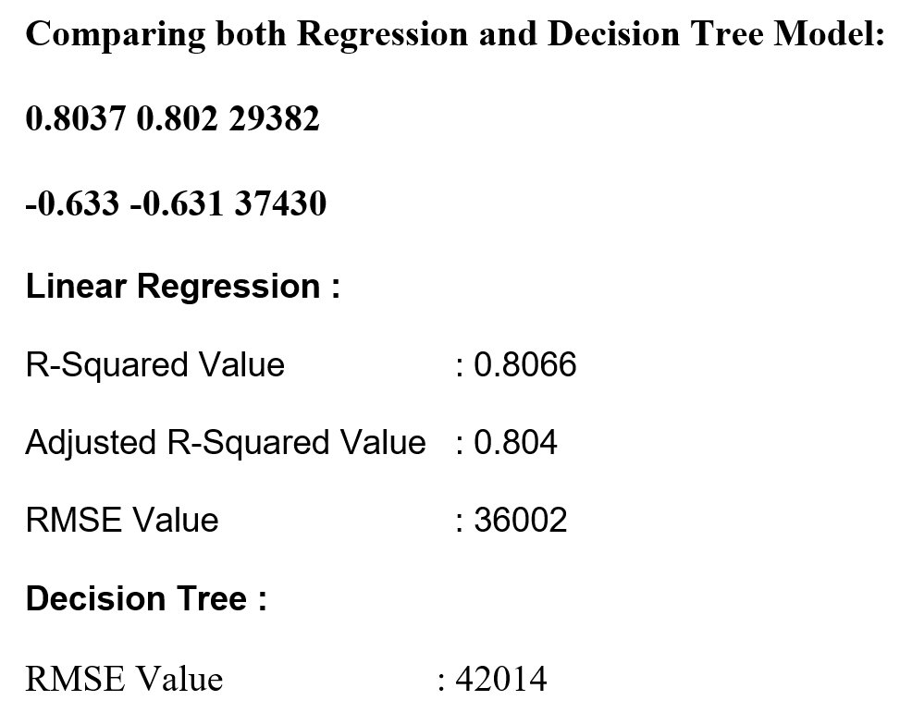
DECISION TREE
One kind of predictive algorithm that plots potential outcomes in accordance with a set of data-driven decision rules is called a decision tree model.
It simplifies complex decision-making processes, which makes it helpful for tasks involving regression and classification.
We evaluated two distinct models, namely linear regression and decision tree.
In order to ascertain which, one would be best for the dataset that was provided.

Slide 8
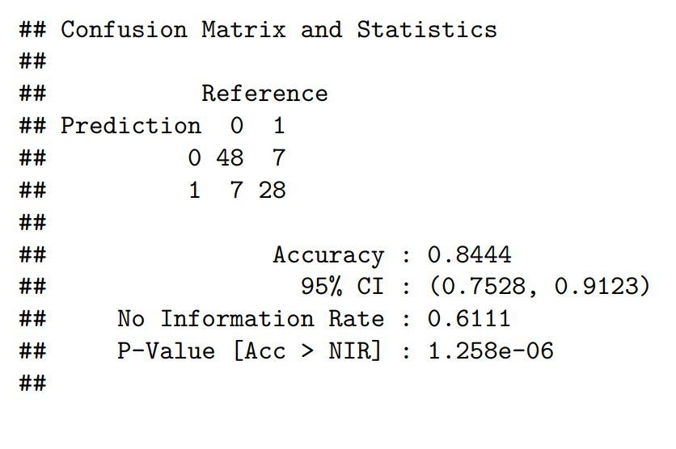
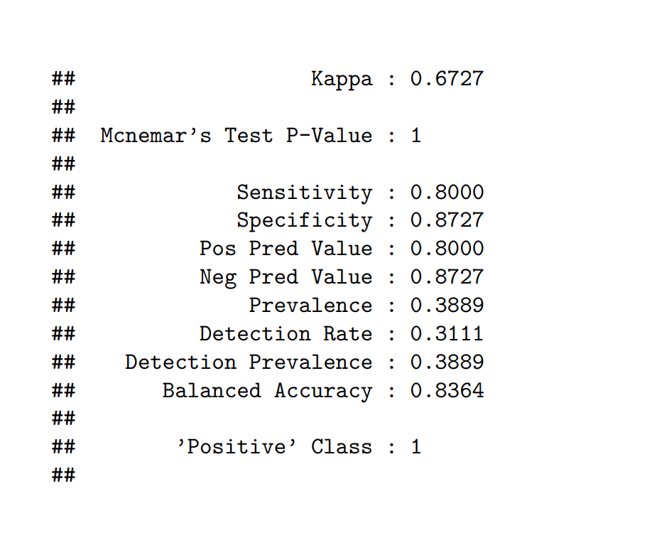
In the second step, we split the "OverallQual" variable into two levels of classes, "0" and "1," using a logistic regression model, and we use the categorical output to make a prediction.

Slide 9

THANK YOU

